Slide 1

Looping Statements in Java

Slide 2

Identify the looping statements used in Java.
Discuss how each looping statements worked.
Demonstrate how looping statements work.
Applying looping statements in creating programs.
Objectives:

Slide 3
A loop statement is a series of steps or sequence of statements executed repeatedly zero or more times satisfying the given condition is satisfied.
Loops can execute a block of code as long as a specified condition is reached.
Loops are handy because they save time, reduce errors, and they make code more readable.
What is a looping statement?

Slide 4
While Loop
Do/While Loop For Loop
Loops in Java

Slide 5


Java While Loop
The loops through a block of code as long as a specified condition is true:
SYNTAX:
while (condition) {
//
}
code block to be executed

Slide 6
Example
In the example below, the code in the loop will run, over and over again, as long as a variable (i) is less than 5:
int i = 0; while (i < 5) {
System.out.println(i); i++;
}

Slide 7


The Do/While Loop
The is a variant of the while loop.
This loop will execute the code block once, before checking if the condition is true, then it will repeat the loop as long as the condition is true.
SYNTAX:
do {
// code block to be executed
}
while (condition);

Slide 8
EXAMPLE
The example below uses a do/while loop. The loop will always be executed at least once, even if the condition is false, because the code block is executed before the condition is tested:
int i = 0; do {
System.out.println(i);
i++;
}
while (i < 5);

Slide 9
Example 2:
Create a program using do/while that displays the even numbers from 1 to 10.
Sample code:
int i=2;
do { System.out.println(i); i=i+2;
}
while (i<=10);

Slide 10
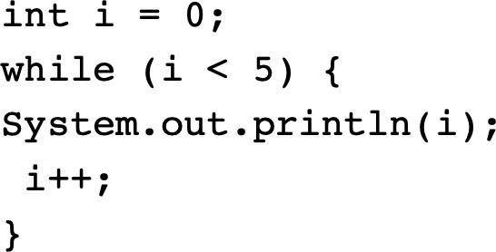
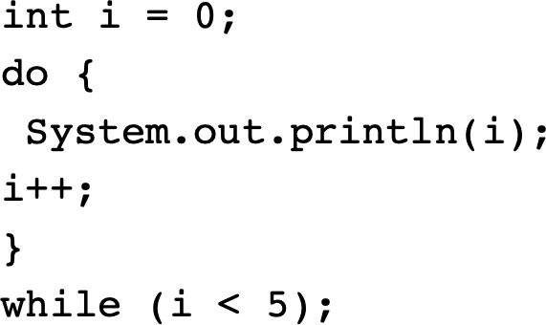
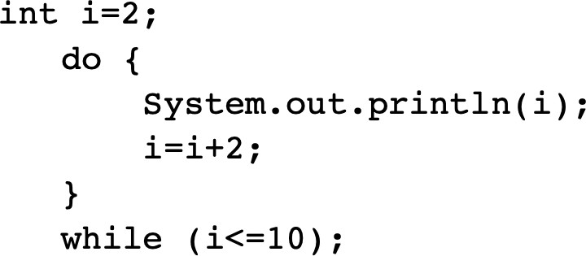
Your turn: Try this code

Slide 11
Sample Problems
Create a program that displays the even numbers from 1 to 10.
Create a program that displays numbers divisible by 5 from 1-50.
Create a program that displays odd numbers from 1 to 20.
Create a program that accepts an input value from the user and displays the sum of the values up to 0.
Sample Input Enter an integer: 5 Sample output The sum is 15.

Slide 12
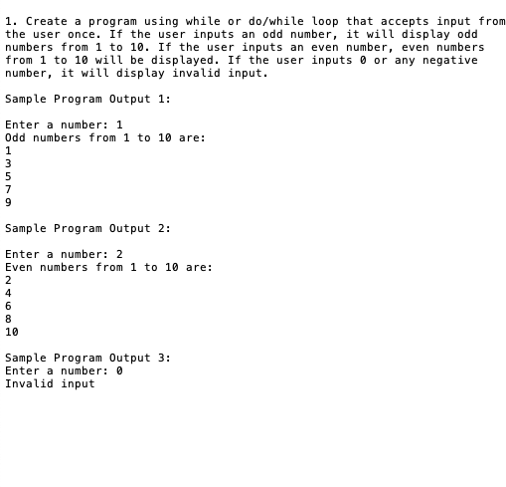
Assignment:

Slide 13










Java For Loop
When you know exactly how many times you want to loop through a block of code, use the for loop instead of a while loop:
SYNTAX:
for (statement 1; statement 2; statement 3) {
// code block to be executed
}

Slide 14
SYNTAX EXPLAINED
Statement 1 is executed (one time) before the execution of the code block.
Statement 2 defines the condition for executing the code block.
Statement 3 is executed (every time) after the code block has been executed.
•

Slide 15



EXAMPLE:
for (int i = 0; i < 5; i++) { System.out.println(i);
}
Statement 1 sets a variable before the loop starts (int i = 0).
Statement 2 defines the condition for the loop to run (i must be less than 5). If the condition is true, the loop will start over again, if it is false, the loop will end.
Statement 3 increases a value (i++) each time the code block in the loop has been executed.

Slide 16
This example will only print even values between 0 and 10:
for (int i = 0; i <= 10; i = i + 2) { System.out.println(i);
}

Slide 17
Java Break and Continue
Break is used to "jump out" of a switch statement.
The break statement can also be used to jump out of a loop.

Slide 18
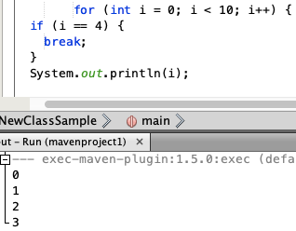
This example jumps out of the loop when i is equal to 4:
for (int i = 0; i < 10; i++) { if (i == 4) {
break;
}
System.out.println(i);
}
Expected output: 0, 1, 2, 3

Slide 19
Java Continue
The continue statement breaks one iteration (in the loop), if a specified condition occurs, and continues with the next iteration in the loop.

Slide 20
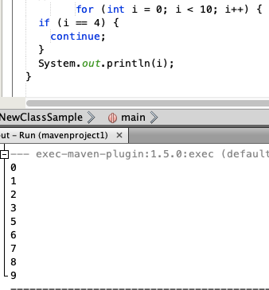
Example:
This example skips the value of 4:
for (int i = 0; i < 10; i++) {
if (i == 4) { continue;
}
System.out.println(i);
}

Slide 21
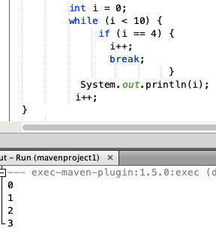
Break and Continue in While Loop
You can also use break and continue in loops:
while
Break int i =
Example 0;
while (i < 10) { System.out.println(i); i++;
if (i == 4) { break;
}
}

Slide 22
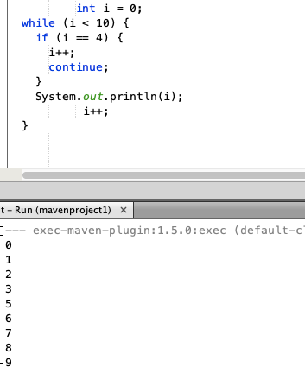
Continue Example
int i = 0;
while (i < 10) { if (i == 4) {
i++;
continue;
}
System.out.println(i); i++;
}

Slide 23








Activity:
Write a program that prompts the user to input an integer and then outputs the number with the digits reversed. For example, if the input is 8, the output should be 87654321.
Write a program that prompts the user to input an integer and based on the inputted integer, it then prints the sum of the even and odd integers.
Sample Program output: Enter an integer: 5
Sum of numbers: 9

Slide 24


Java break and continue

Slide 25
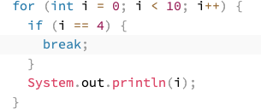
The break statement
The break statement can also be used to jump out of a loop.
This example stops the loop when i is equal to 4:

Slide 26
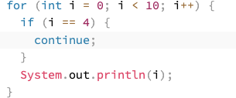
The continue statement
The continue statement breaks one iteration (in the loop), if a specified condition occurs, and continues with the next iteration in the loop.
This example skips the value of 4:

Slide 27
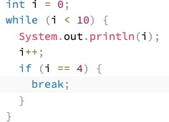
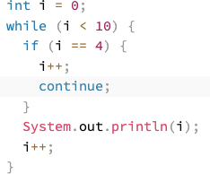
Break and Continue in While Loop
You can also use break and continue in while loops:

Slide 28
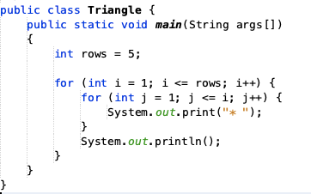

Looping Exercises:
Discuss the output of the given code:
Code
Output

Slide 29
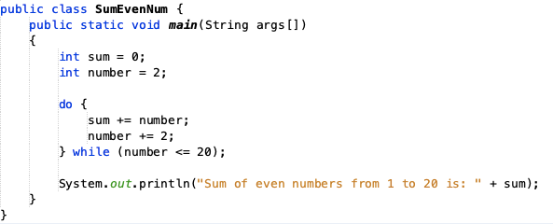

Looping Exercises: Discuss the output of the given code.
Code
Output

Slide 30
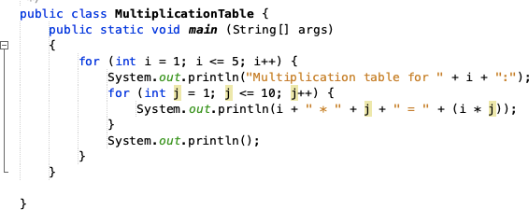
Looping Exercises
Code

Slide 31
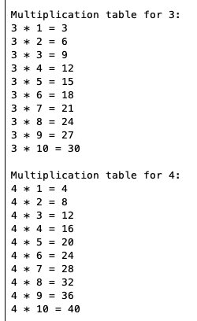
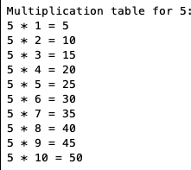
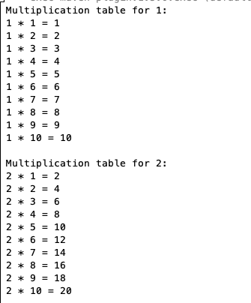
Looping Exercises
Output

